Slide 1
Northcentral University Lambda Eta Chapter
Building Your Personal Brand –
A Key to Your Future Success
Richard T. Minoff
May 3, 2018

Slide 2
What We’ll Cover Today…

Slide 3
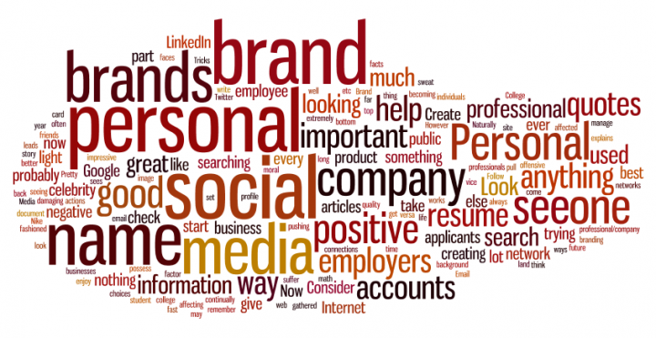
The Brand Called ‘YOU’

Slide 4
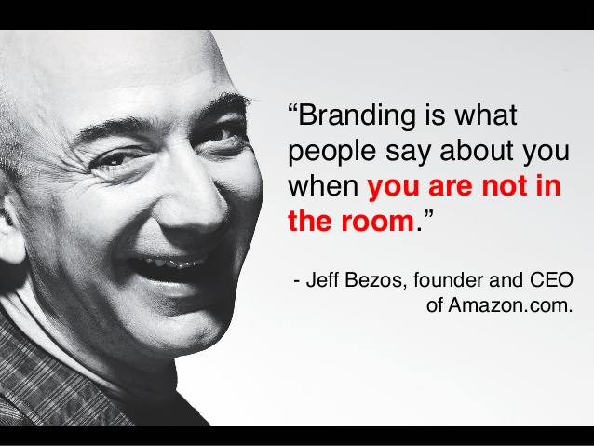
What is Personal Branding?
Powerful, clear, positive idea that comes to mind when people think of you
It’s what you stand for – values, abilities, and actions
Tells your audience 3 things:
Who you are
What you do
What makes you different; or how you create value for others
Notes:
The term personal branding is relatively new. However, the phenomenon of people “instant labeling” based on reputation is as old a human character itself.
Personal branding makes who you are, what you do, and why you do it more clear to those around you, and THAT brings new opportunities your way.
Remember, when building a personal brand, it’s important to focus on who you are and communicating that message, not making something up and pretending to be someone you’re not.
People reinvent themselves all the time—to take on a new challenge, shift into more meaningful work, or rebut perceptions that have hindered their career progress.

Slide 5
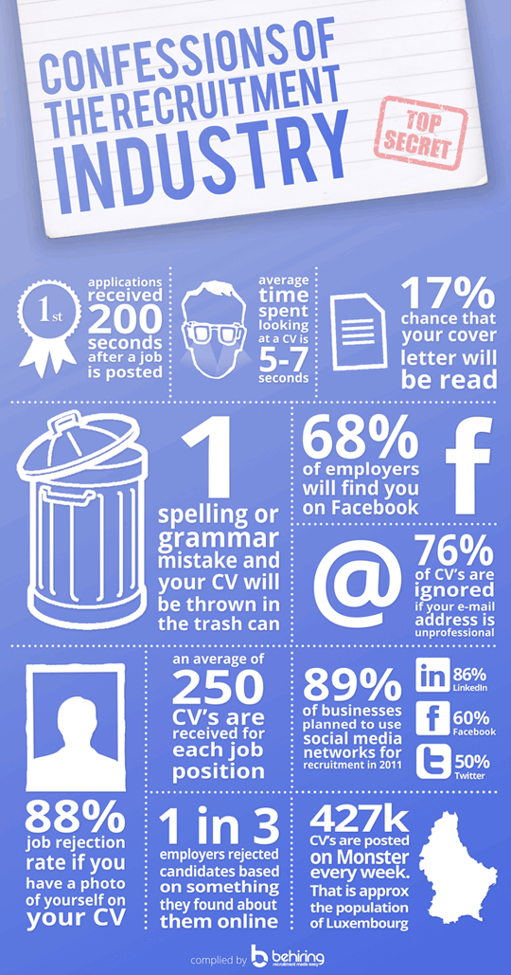
Why Do You Need a Personal Brand Development Plan?

Slide 6
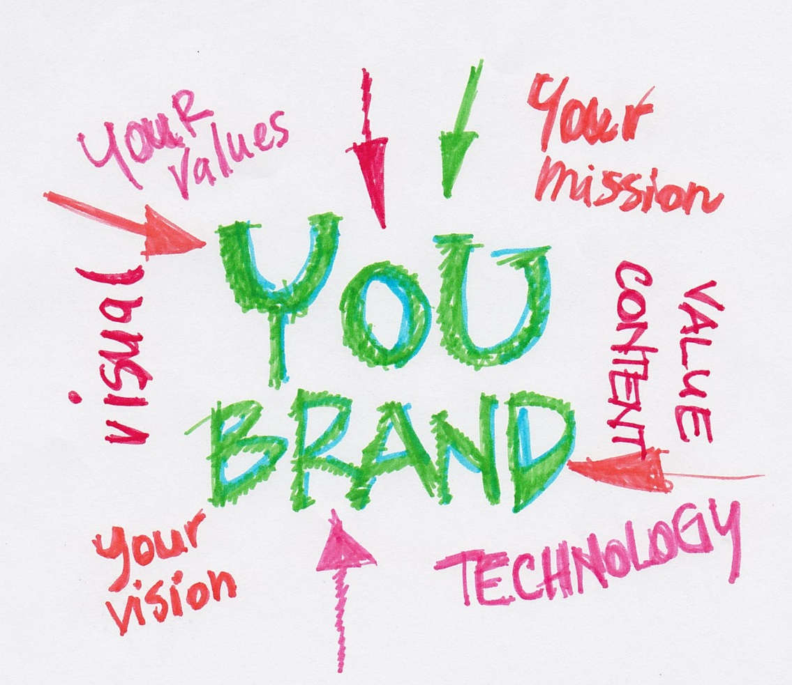
Why is Building A Personal Brand So Important?
More opportunities
Better opportunities
Right opportunities
Increased earning potential
Added perceived value
Greater recognition
“Top-of-Mind” status
Increased credibility

Slide 7
How Do You Use Personal Branding?
To introduce yourself verbally, visually, and in writing
To create an aura about what you do and how you do it
To demonstrate to others about your beliefs, values, and abilities
To change/clarify/create perceptions
To influence

Slide 10
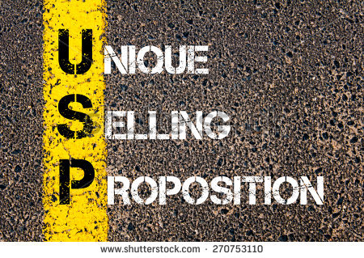
What is Your Personal Brand?

Slide 11
Ask Yourself…
What makes you special?
What are your greatest strengths?
What differentiates you from others?
How does your uniqueness translate to value?
What are your most significant accomplishments?
What do people come to you for?
What do you want to be known for?
What do you want others to think when they hear your name?

Slide 12
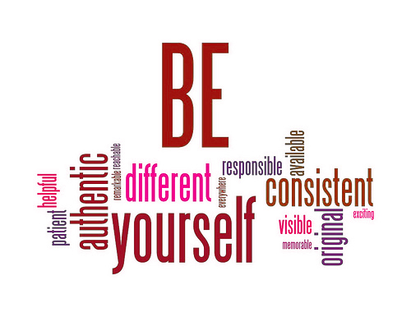
Building Your Personal Brand – Personal Development Assignment
Think through the questions posed and brainstorm your inputs
Develop ‘your personal USP’
Develop ‘your personal brand statement’ – a memorable, punchy sentence that becomes your mantra in your communications
Think in terms of what will set you apart from others but it must be authentic (maybe even a bit aspirational)

Slide 13
Brand Statement Examples
“I help businesses and individuals build and promote lasting brands.”
“I am a global brand strategist and visionary who creates opportunity for my clients and their brands”
“I am a social media consultant who specializes in helping people best utilize LinkedIn and other social media”
“I am an influence connector who helps people build personal and professional relationships”

Slide 14
How Do We Communicate a Personal Brand?
EVERY INTERACTION IS AN OPPORTUNITY

Slide 15
Create and Express Your Brand Personality?

Slide 16
What’s a Brand Personality & Persona
Consider yourself as a business with a personality which connects because people have relationships with personalities not objects
Start by describing your personality as someone else would describe you
It’s like your brand’s flavor
Adjectives!
M&M is a registered trademark of Mars, Inc.

Slide 17
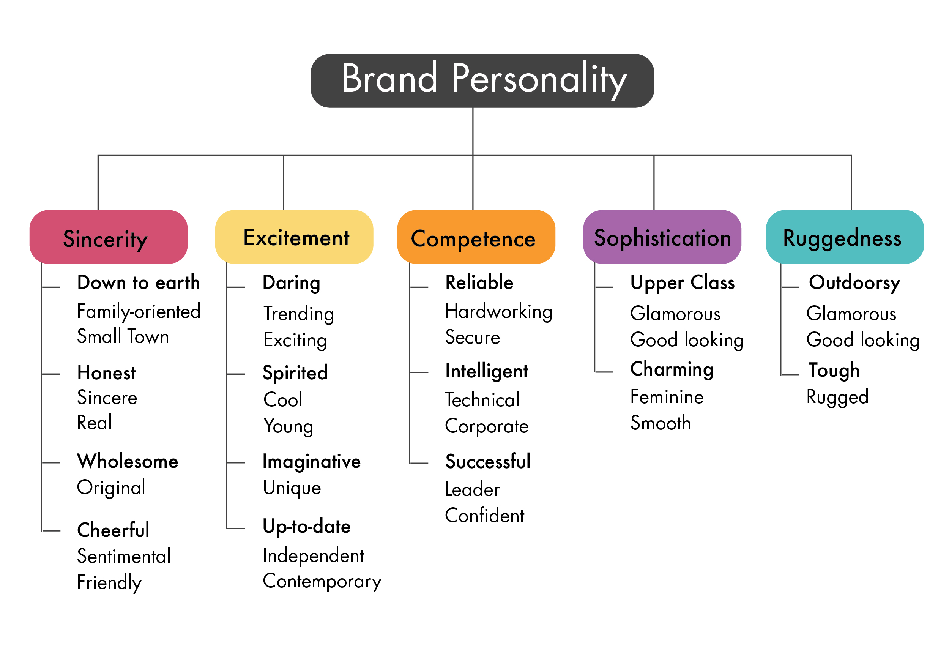
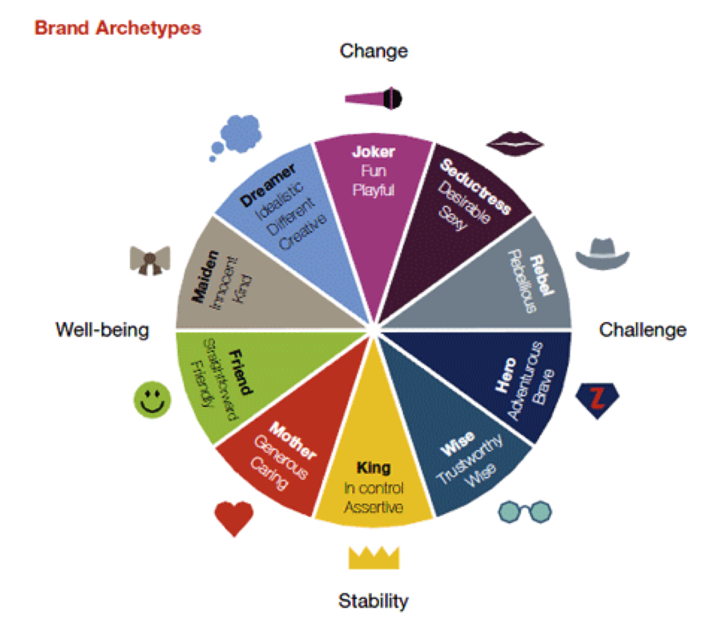
Getting Started With Developing Your Brand Personality & Persona

Slide 18
Building Your Personal Brand – Personal Development Assignment
Work hard to assess what your personality is from your perspective and from someone else’s perspective
Develop ‘your personal brand personality as a series of 5-7 personality traits that distinguish you
Once you’ve thought about your personality attributes, how would you describe that as a persona – develop a phrase or think of a person that epitomizes you

Slide 19
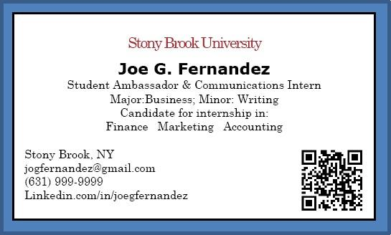
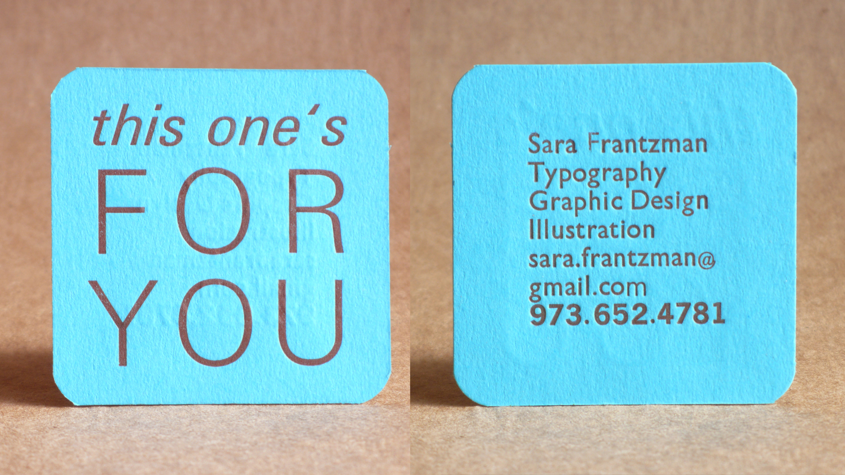
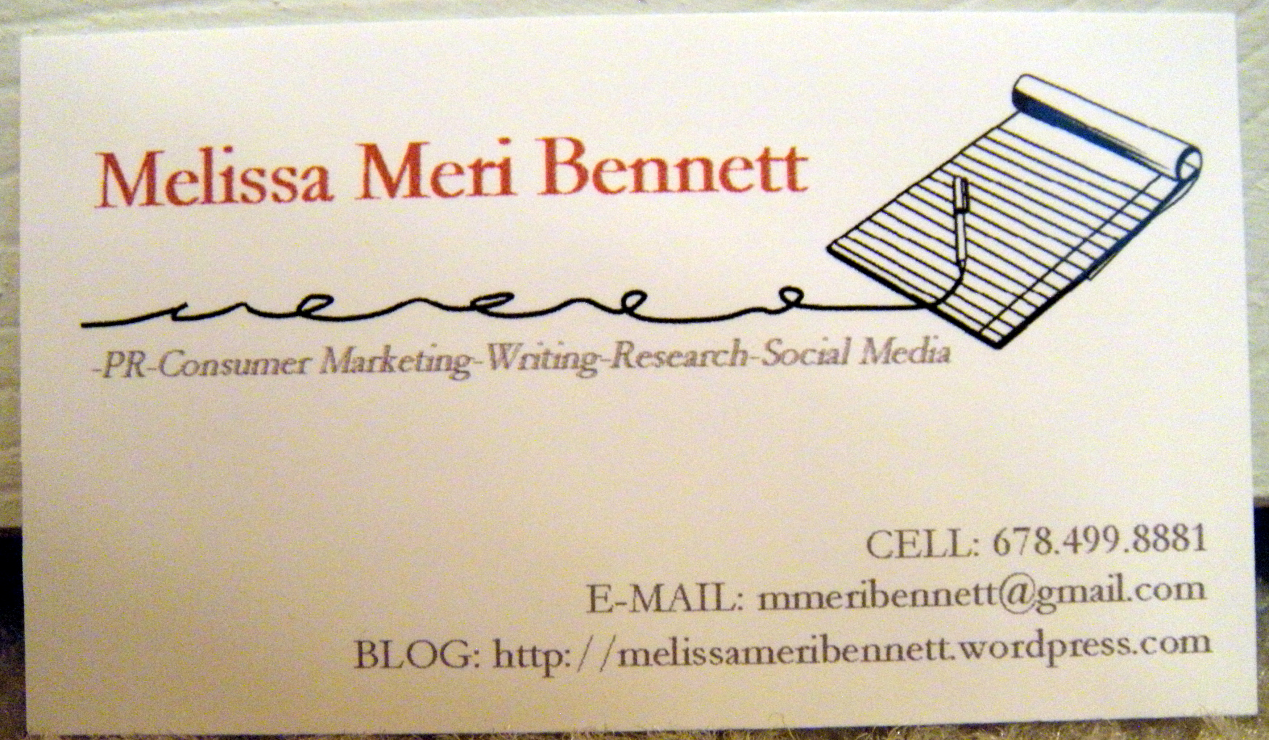
Building Your Personal Brand With Imagery / Logo / Taglines
Words – Name and tag line
Icon – picture, symbol, or image
Color – the primary and secondary color
Tip: Colors have meaning. Choose them carefully.
Tip: Search “psychology of color” before making your final color choice to ensure the colors align with the feeling you want to create.

Slide 20
The Powerful World of Color
Red = power, passion, excitement, energy, courage
Green = money, envy, environment, earth, youthfulness
Blue = trust, integrity, communication, serene, calming
Purple = luxury, decadence, whimsy
Black = luxury, glamour, sophistication, death, emptiness
Yellow = fun, friendly, happiness
Orange = fun, playful, social, physical comfort, warmth
Pink = feminine, love, nurturing, caring, sweet
Brown = warmth, safety, reliability, dependability, earth

Slide 21
1 Global Partners, LLC

Slide 22
Personal Brand Communication Today
Select the appropriate mediums
Doing everything everywhere = little return
How does your audience get its information?
Online/offline

Slide 23
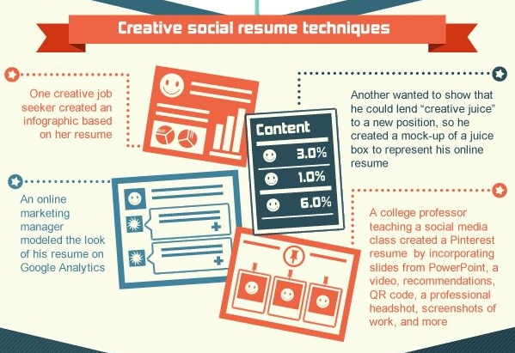
Be Smart, Creative and Stand Apart

Slide 24
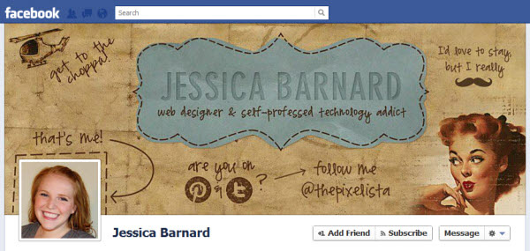
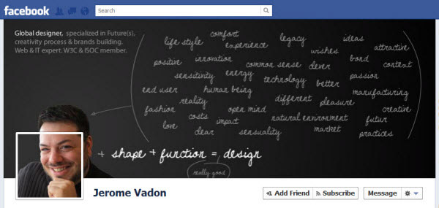
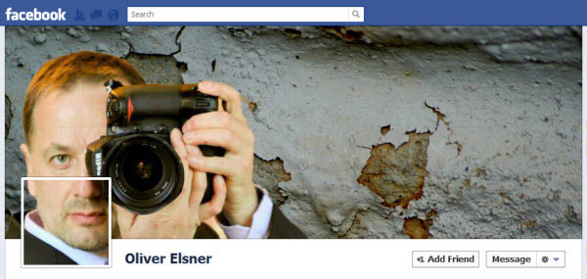
The Objective is to Separate Yourself From Others!

Slide 25
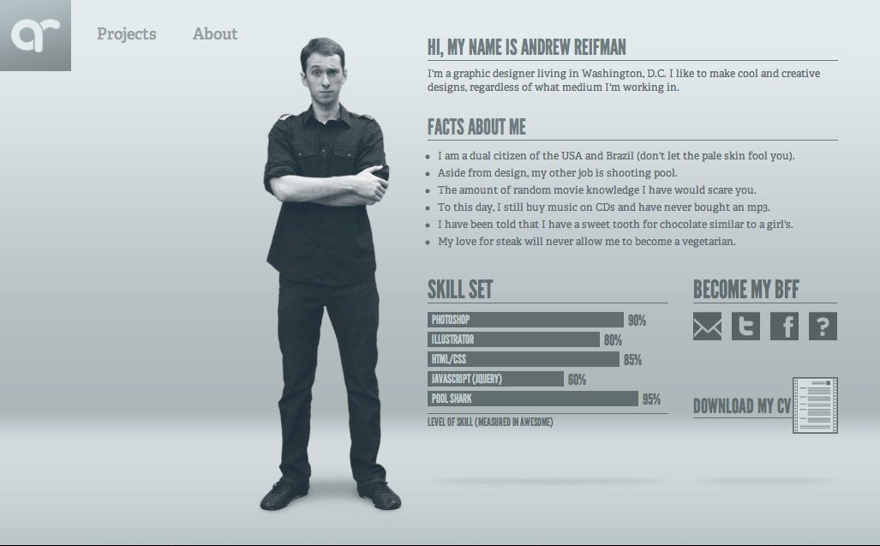
The Objective is to Separate Yourself From Others

Slide 26
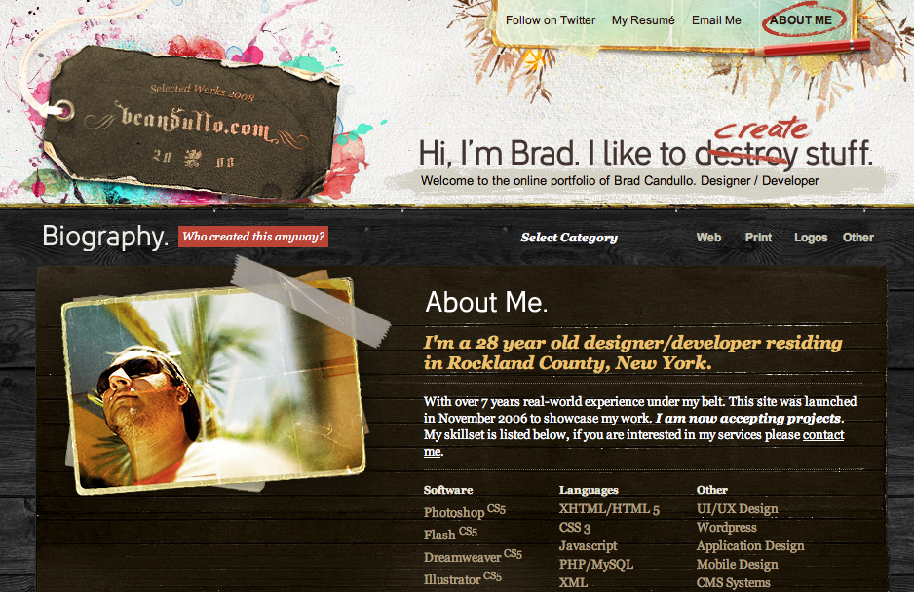

Slide 27
Now Its Up to The Brand Called…YOU!!!

Slide 28
Questions and Contact Information
Connect at LinkedIn via Richard Minoff or rminoff@1gblp.com

Slide 29
© 2018 1 Global Partners LLC. All rights reserved. No part of this can be reproduced in any form by any means (including electronic storage and translation into a foreign language) without prior agreement and written consent of 1 Global Partners, as governed by the United States.

