Slide 1
Hiring for Performance and Retention: Examining the Relationship between Cognitive Fit and Employee Turnover in the U.S. Navy
Dr. Renee J. Squier, CAPT, U.S. Navy

Slide 2
Agenda
My research
Choosing a topic that matters (to you & others)
Draw a picture to visualize the connections
What if your results don’t support your hypothesis?
It’s like an elephant…
Why did I do it?
Why I started…
Why I finished…
Why it mattered…

Slide 3
Abstract
Retaining top-performing talent is one of the most fundamental human resource challenges facing organizations today. Strong retention is critical to workforce quality and controlling human resource costs—especially in an entry-level hiring system like the U.S. Navy.

Slide 4
Introduction
Employee fit is the compatibility between an individual and his or her work environment.¹
Shown are the conceptualizations of fit, the relationships between them, and the types pertinent to this research.¹
Most fit dimensions are measured subjectively.²
Cognitive fit can be measured objectively using the Armed Services Vocational Aptitude Battery (ASVAB) and comparing a person’s score to a job requirement.

Slide 5
Depiction of expected relationship³⁴
When an employee’s cognitive ability is a good fit for the cognitive demands of a job, the likely relationship is that employee turnover will be low.
If an employee’s cognitive ability is either over- or under-matched to the demands of a job, the likely relationship is that employee turnover will be high.

Slide 6
Research
Research Question: To what extent does cognitive fit, gender, and length of service predict employee turnover amongst U.S. Navy enlisted sailors?
Design: non-experimental, quantitative study using multinomial logistics regression to determine if cognitive fit, gender, and length of service (as the predictor variables) have a relationship to employee turnover (as the criterion variable) in a way that is measurable and significant.
Data: secondary case-file data from the U.S. Navy’s Career Waypoints personnel database
Population: active component of the U.S. Navy for 2014, which was approximately 327,000 personnel
Sample: 56,812 active U.S. Navy enlisted sailors, paygrades E1 thru E6, with up to 14 years of service who made a retention decision in 2014
Instrument: Armed Services Vocational Aptitude Battery
Dependent Variable: Employee turnover outcomes. 3 possible categories: involuntary separation, voluntary separation, or reenlistment

Slide 7
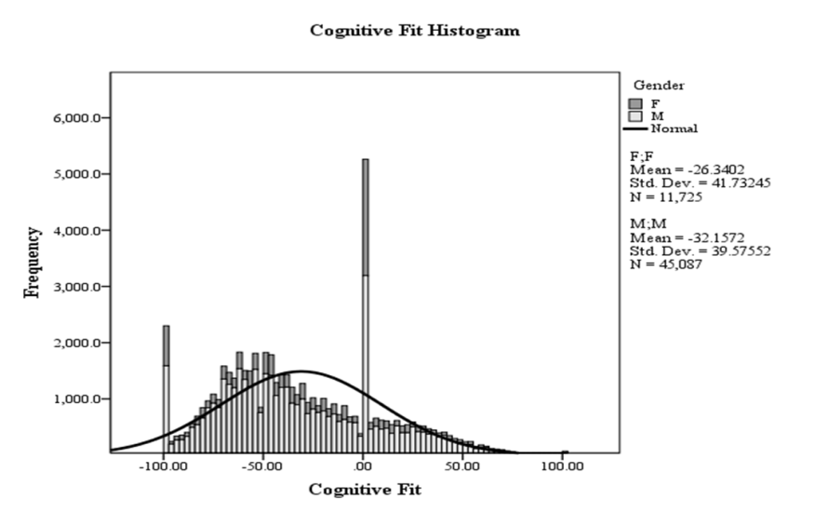
Results & Implications
Mean values for cognitive fit overall and in all three turnover outcome groups were below the optimum value of zero, indicating that sailors in this dataset have less than optimum cognitive fit and are underqualified for their assigned career fields
Cognitive fit explained less than 1% of employee turnover outcomes
Results differed from previous Navy research, which indicated that sailors with high cognitive fit were less likely to separate⁵
Results also differed from previous research on concepts related to employee turnover that used a broader definition and a more subjective measurement of fit
Many Navy sailors are not being placed in best fit jobs.
Objective measurements of cognitive fit are not enough to predict future employee turnover.

Slide 8
Other Thoughts…
Why did I start…
Why did I finish…
Why does it matter…

Slide 9
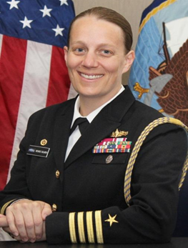
Questions?
Dr. Renee J. Squier, CAPT, USN: renee.squier@gmail.com

Slide 10
References
Kristof-Brown, A. L., & Guay, R. P. (2011). Person-environment fit. In S. Zedeck (Ed.) APA handbook of industrial and organizational psychology: Maintaining, expanding, and contracting the organization (Vol. 3, pp. 3-50). Washington, DC: American Psychological Association. doi:10.1037/12171-001
Freund, P. A., & Kasten, N. (2012). How smart do you think you are? A meta-analysis on the validity of self-estimates of cognitive ability. Psychological Bulletin, 138, 296-321. doi:10.1037/a0026556
Maltarich, M. A., Nyberg, A. J., & Reilly, G. (2010). A conceptual and empirical analysis of the cognitive ability-voluntary turnover relationship. Journal of Applied Psychology, 95, 1058-1070. doi:10.1037/a0020331
Yerkes, R. M., & Dodson, J. D. (1908). The relation of strength of stimulus to rapidity of habit-formation. Journal of Comparative Neurology & Psychology, 18, 459. doi:10.1002/cne.920180503
Department of the Navy. (2012). RIDE measures of effectiveness (OPNAV N132). Washington DC: Hewlett Packard

